Slide 1
English for human resources

Slide 4
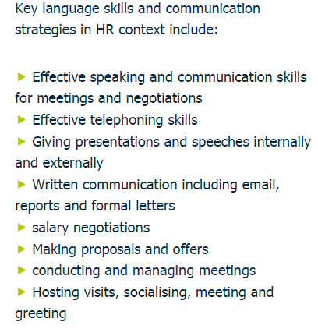

Slide 5
